Slide 1
Apache Spark Apache Kafka

Slide 2

Dinesh Kumar P
Technical Product Manager
Bold BI,
Syncfusion Software
dinesarun@hotmail.com
Notes:
Hello everyone! Microsoft products always comes as huge and changing fast. It comes in handy while choosing services that does storage, processing, analytics for any kind of industry solutions and use cases.
Well, Good morning guys. I am Dinesh Kumar Prabakaran, “Product Manager” at “Syncfusion Software” for “Dashboard Analytics” team. And I am pretty happy to present this Webinar – “Engage Customers with Personalized Retail Experiences” in Azure Vidyapeeth to this wonderful audience. Here we go!

Slide 3

Why Spark?
Notes:
Christmas season – All orders, click stream events etc. might be required to process asap. To know top selling products, inventory status etc. to boost up the sales.

Slide 4
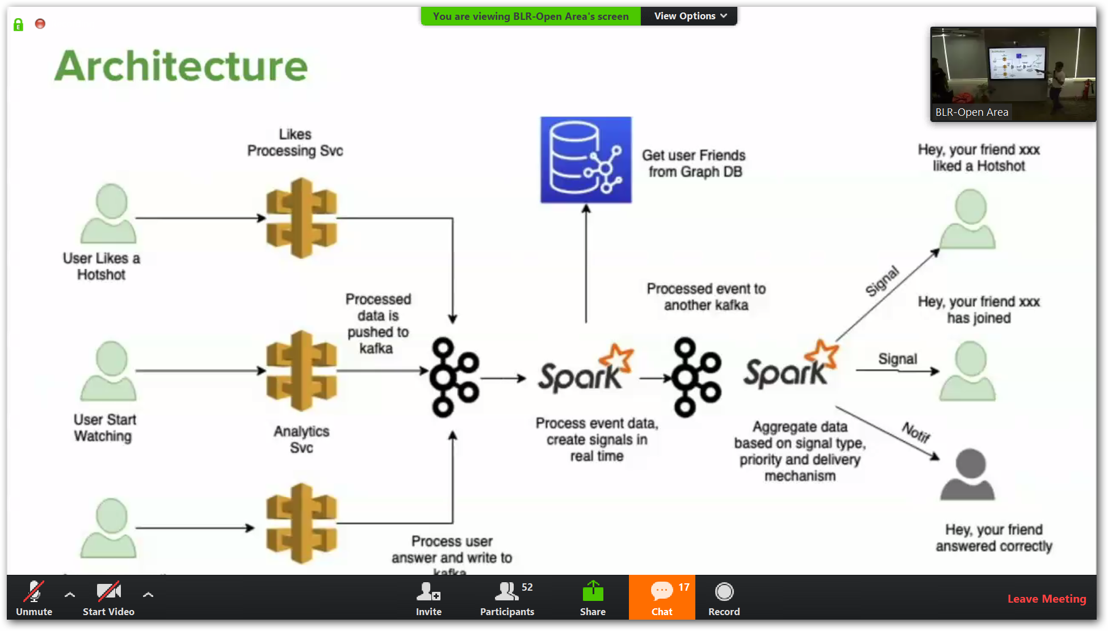
Hotstar

Slide 5
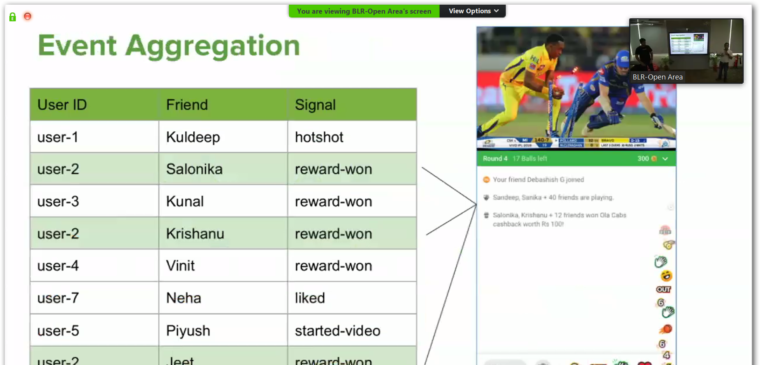

Slide 6
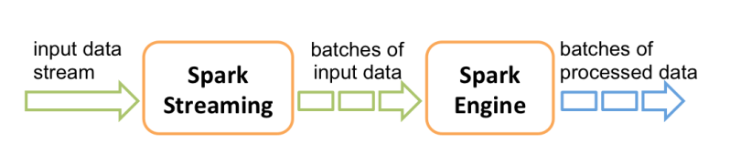
Apache Spark Streaming
Separate library in Spark to process continuously flowing streaming data.

Slide 7
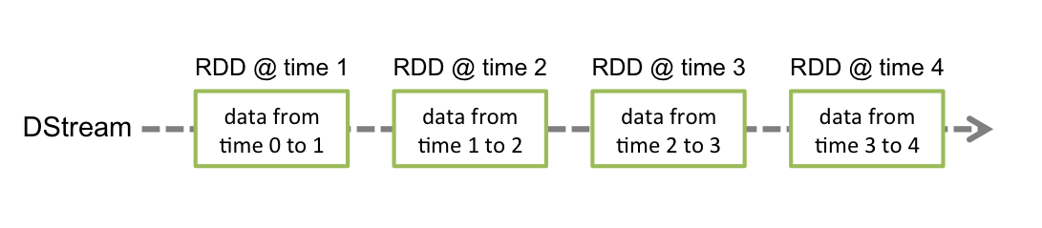

Slide 8
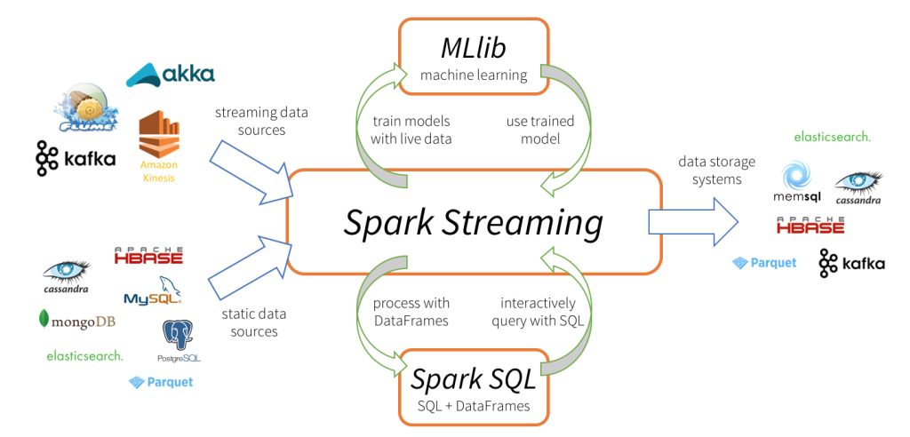

Slide 9
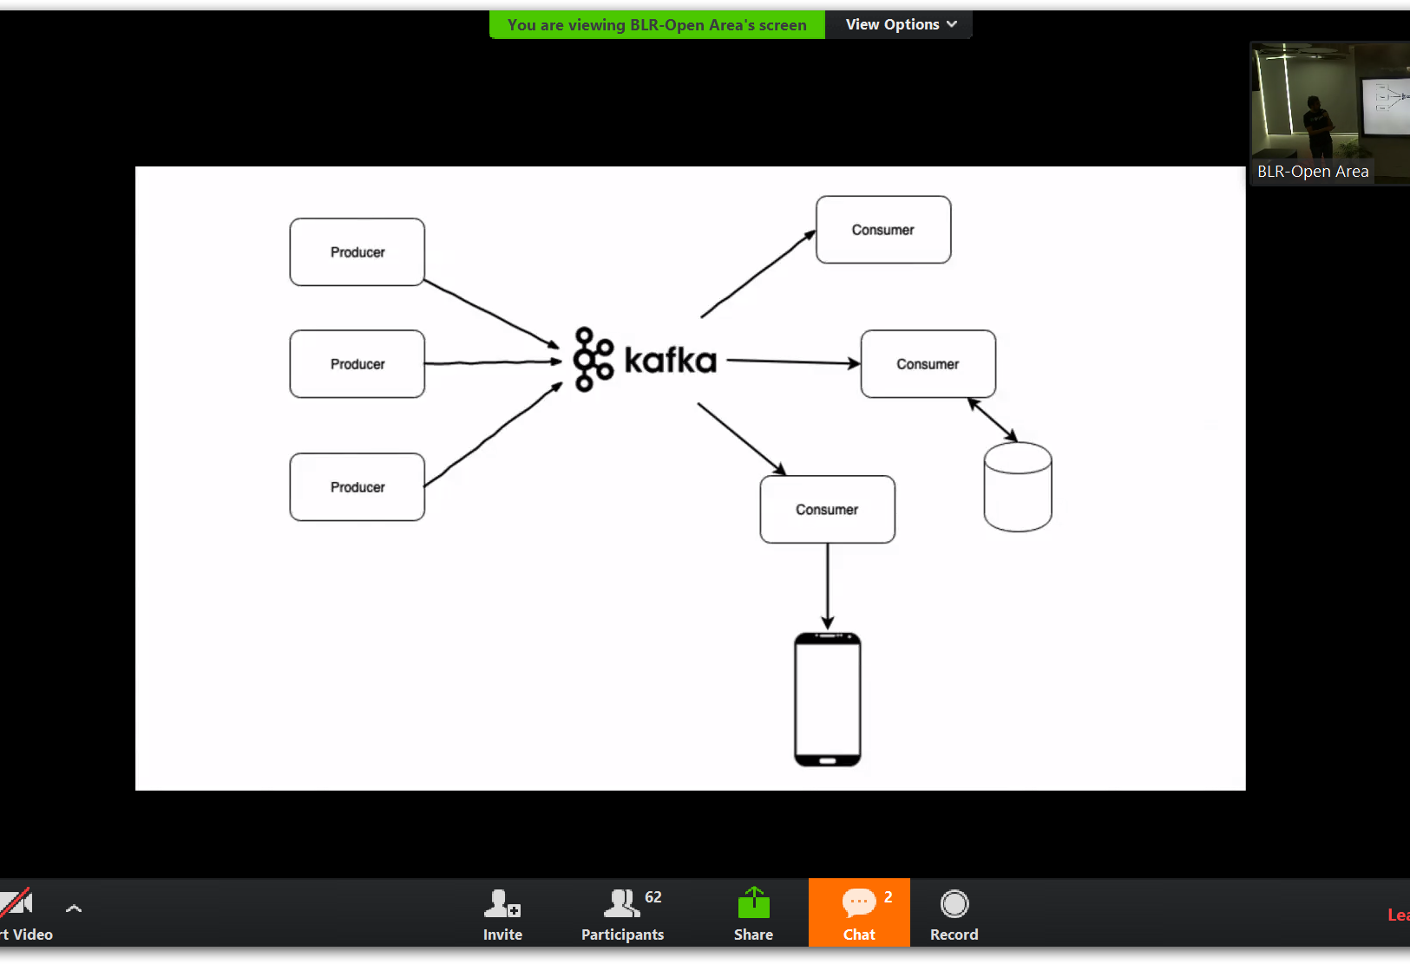
Apache Kafka
Kafka is a little different from your average messaging technology.

Slide 10
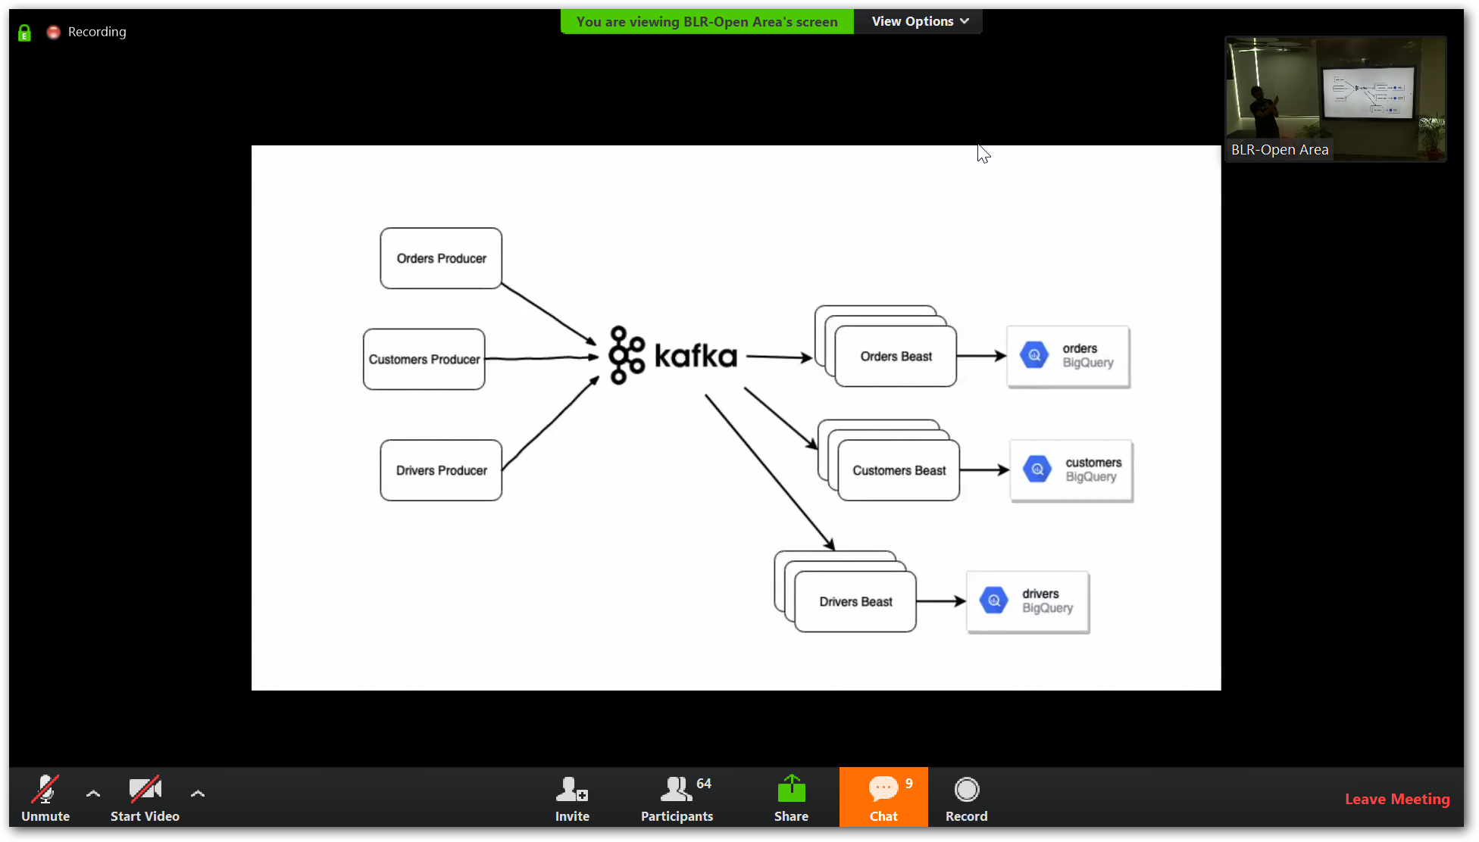

Slide 11
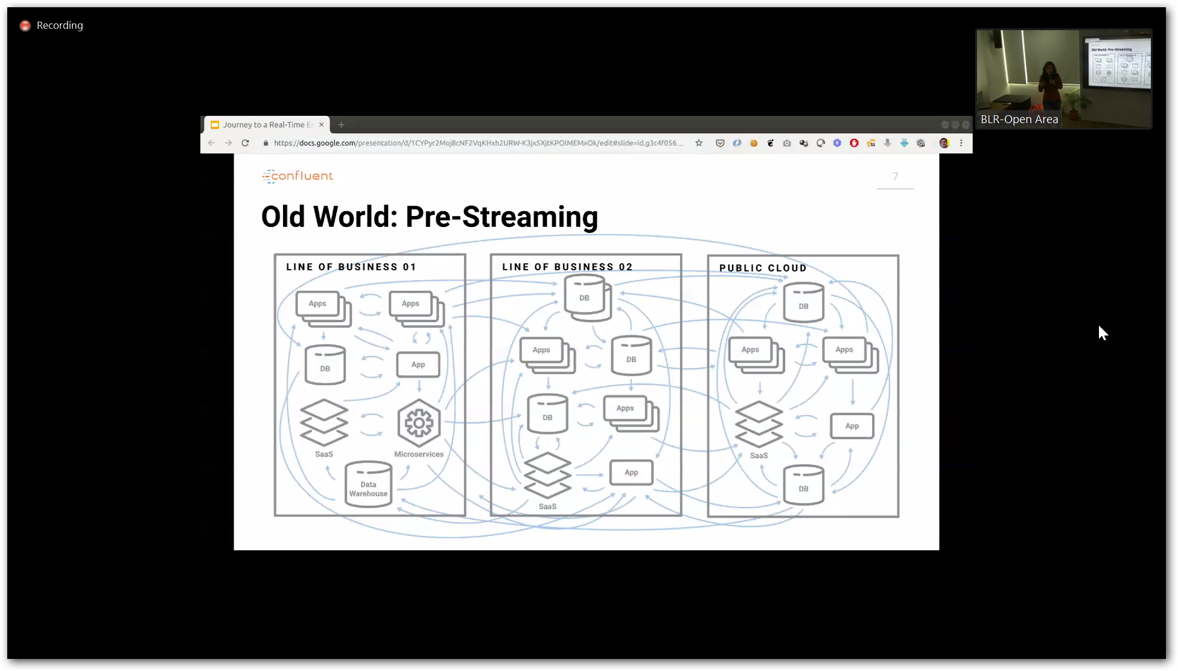

Slide 12
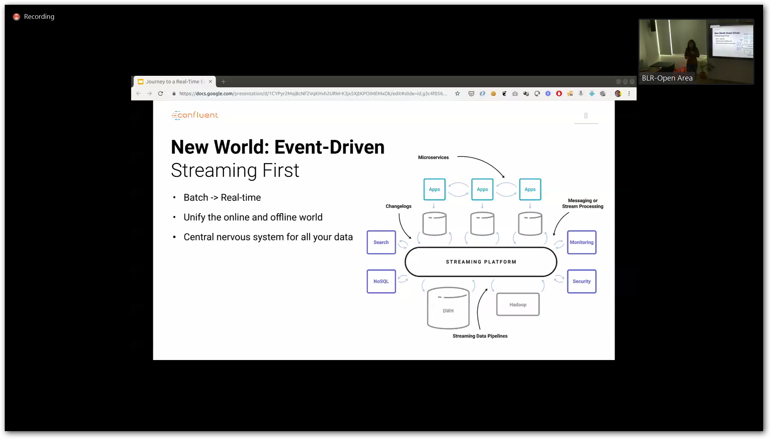

Slide 13
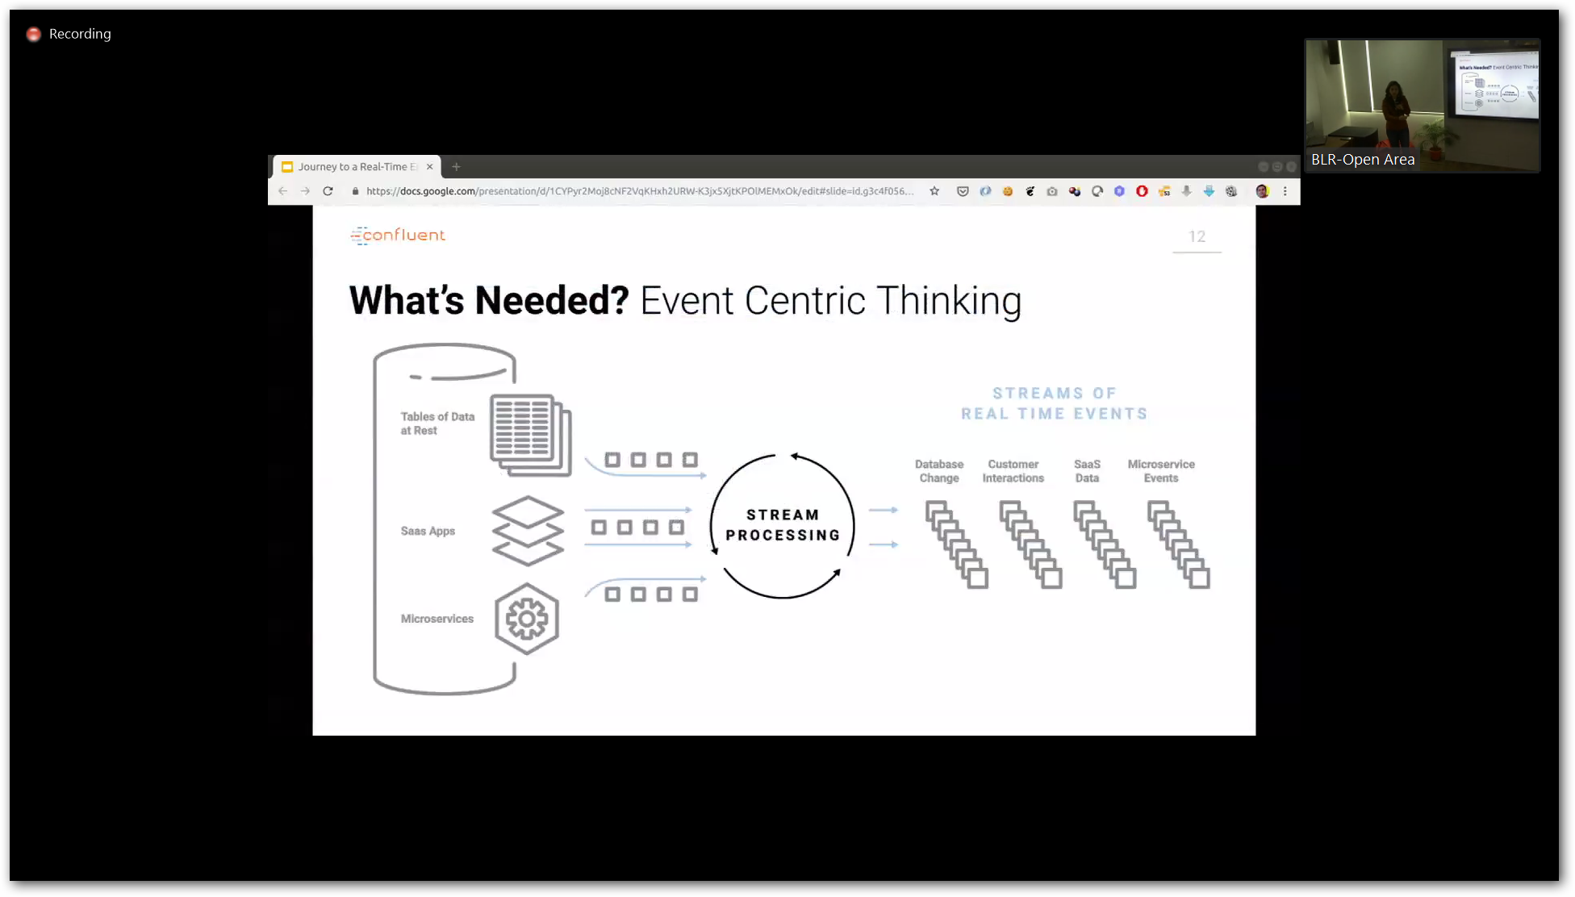

Slide 14
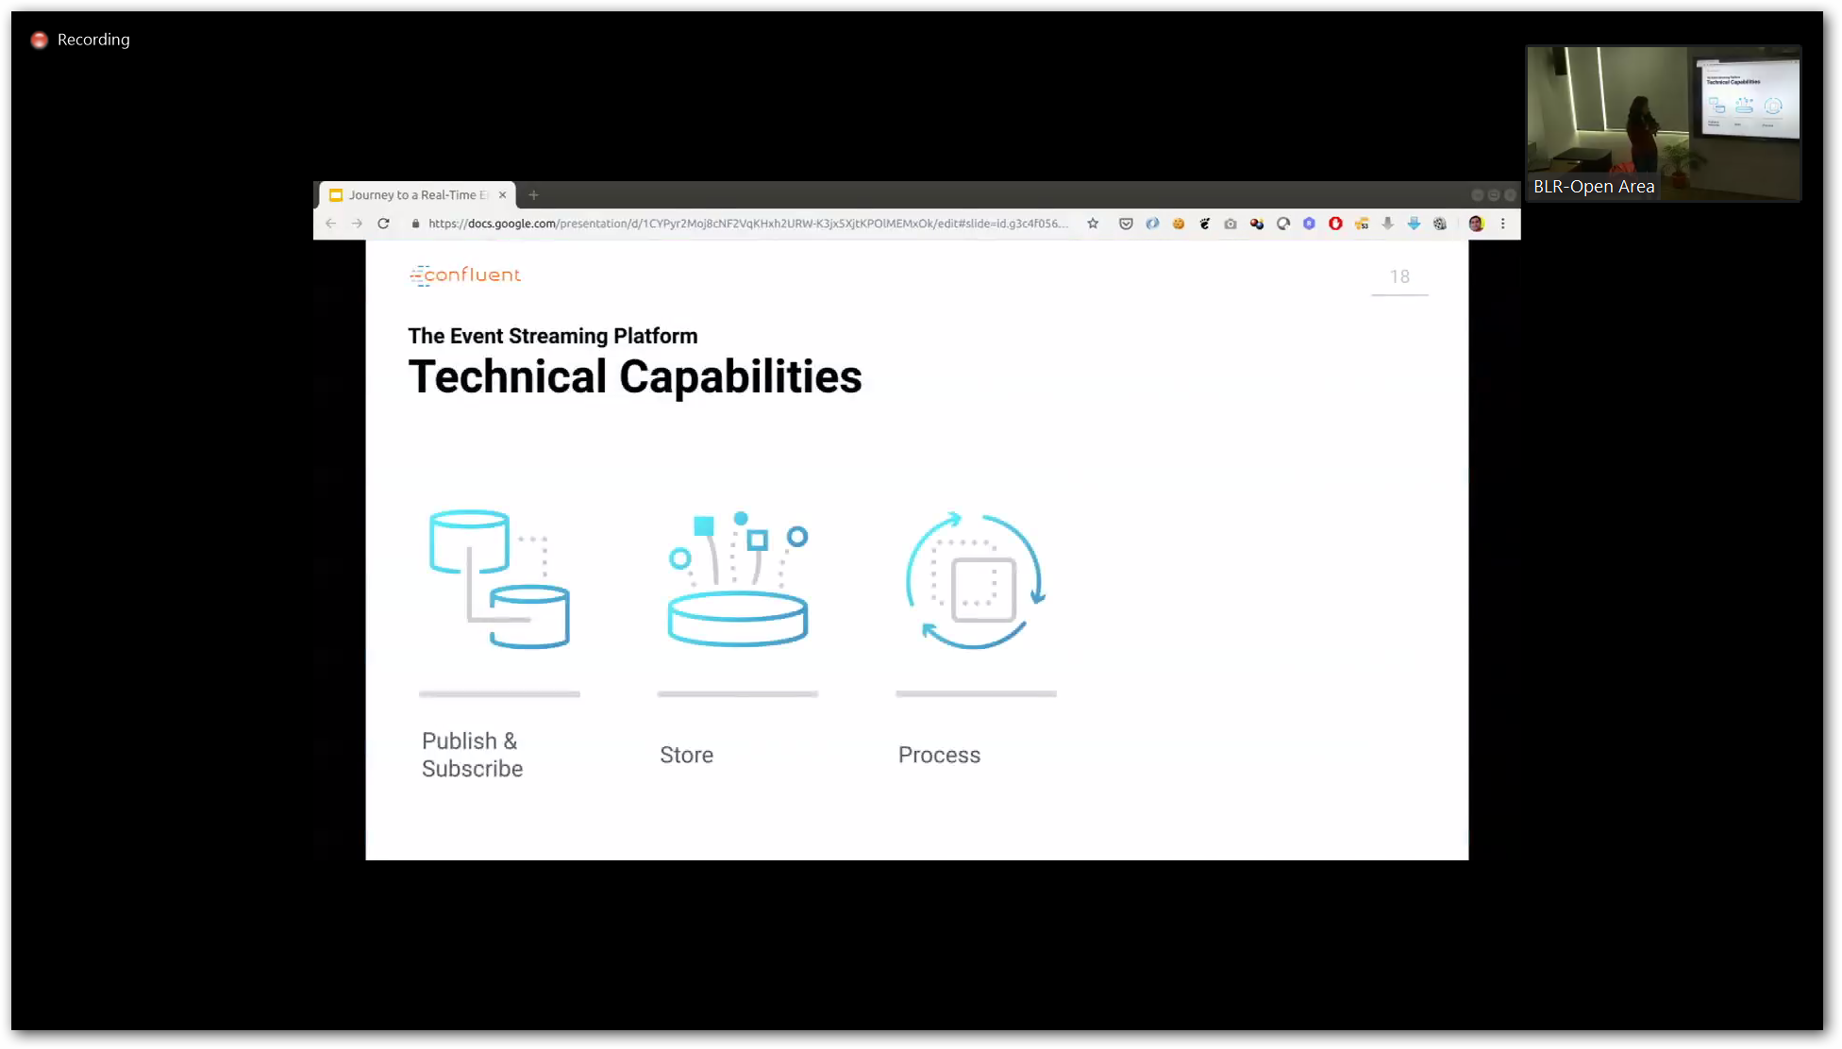

Slide 15
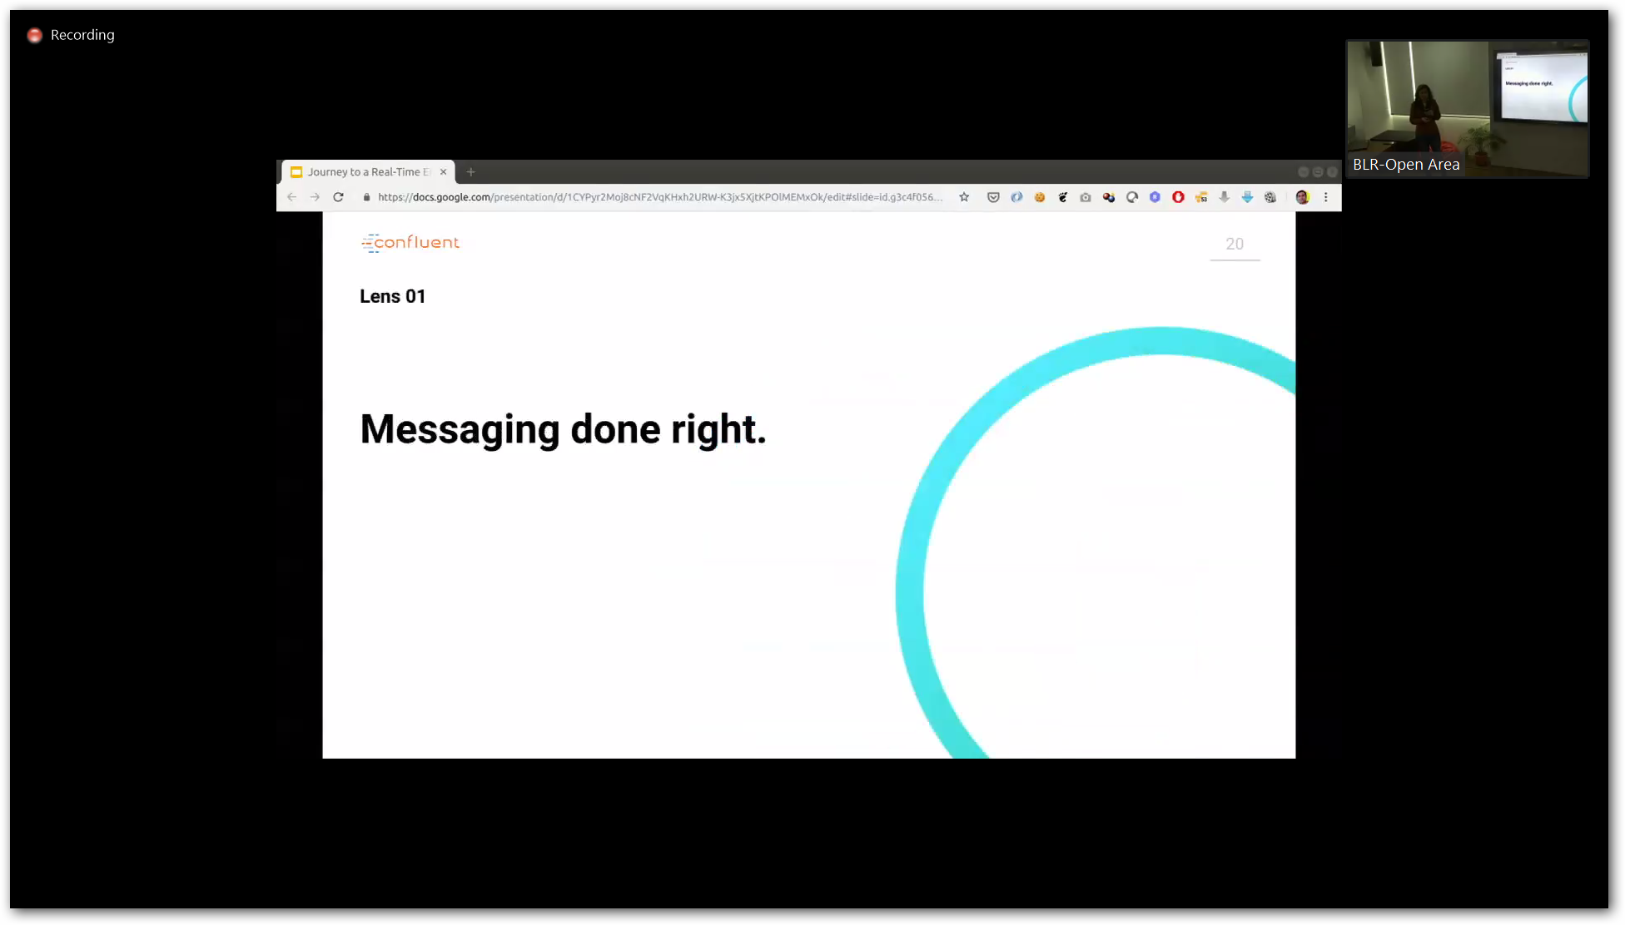
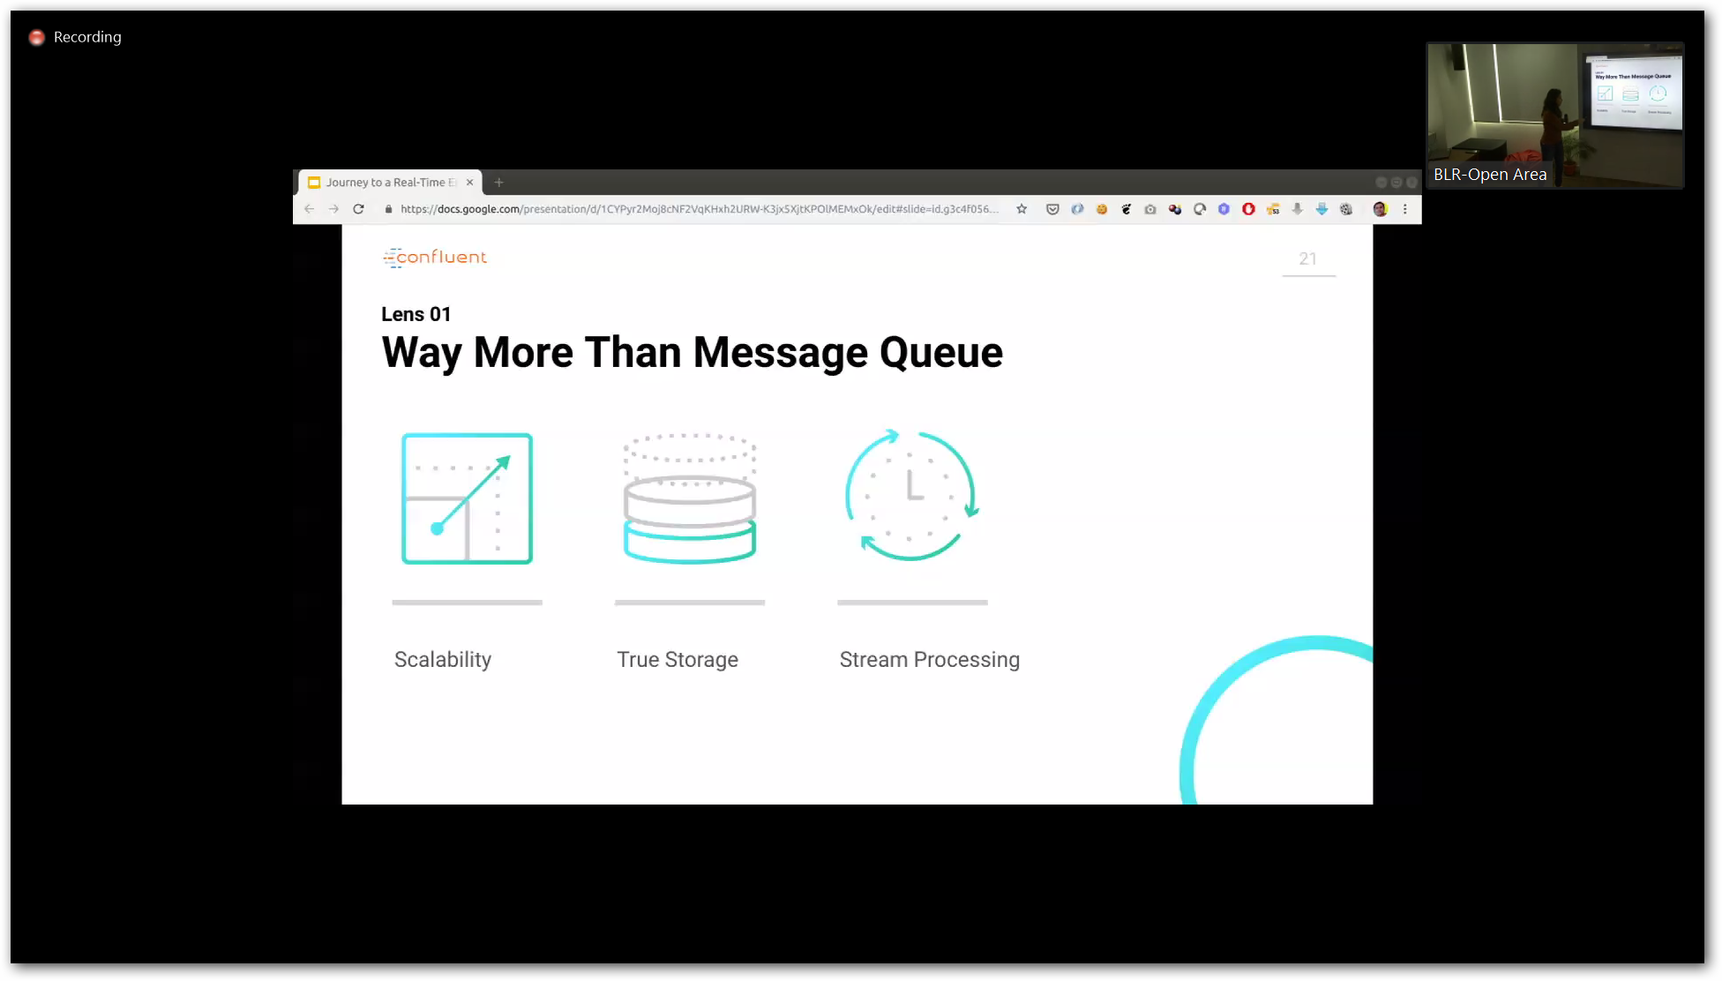
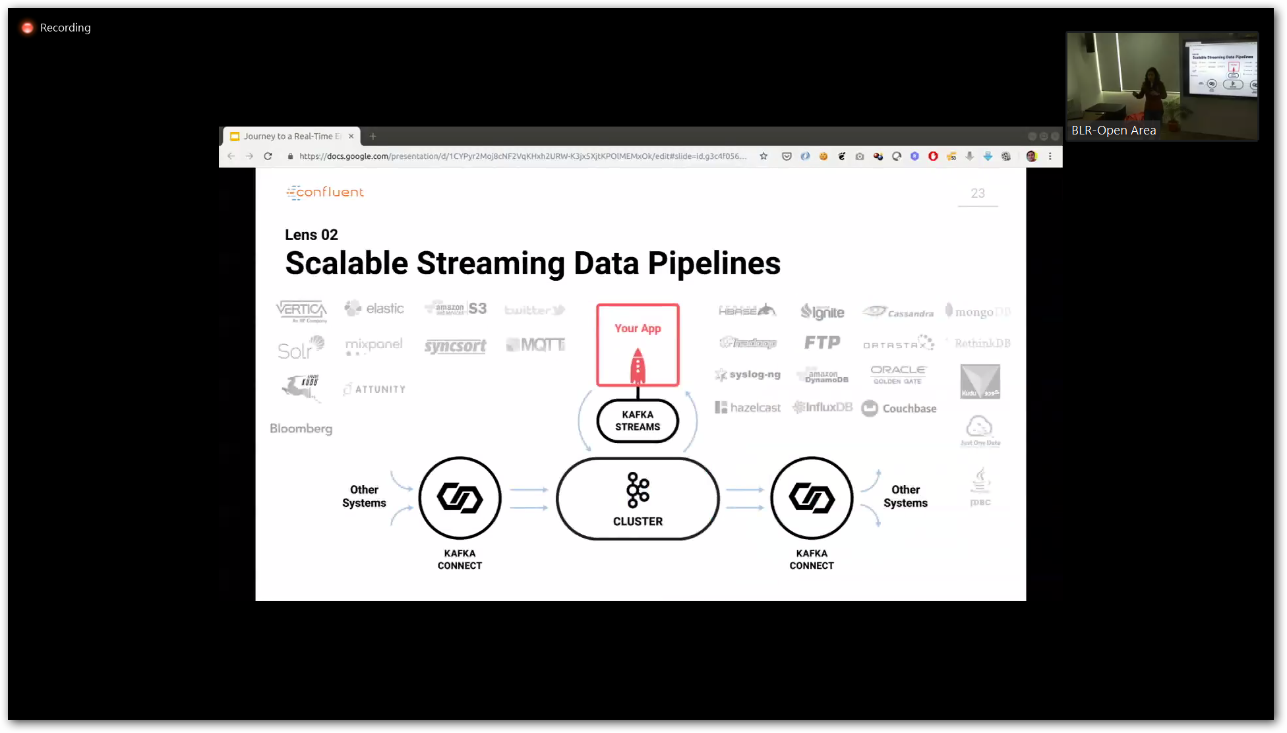

Slide 16
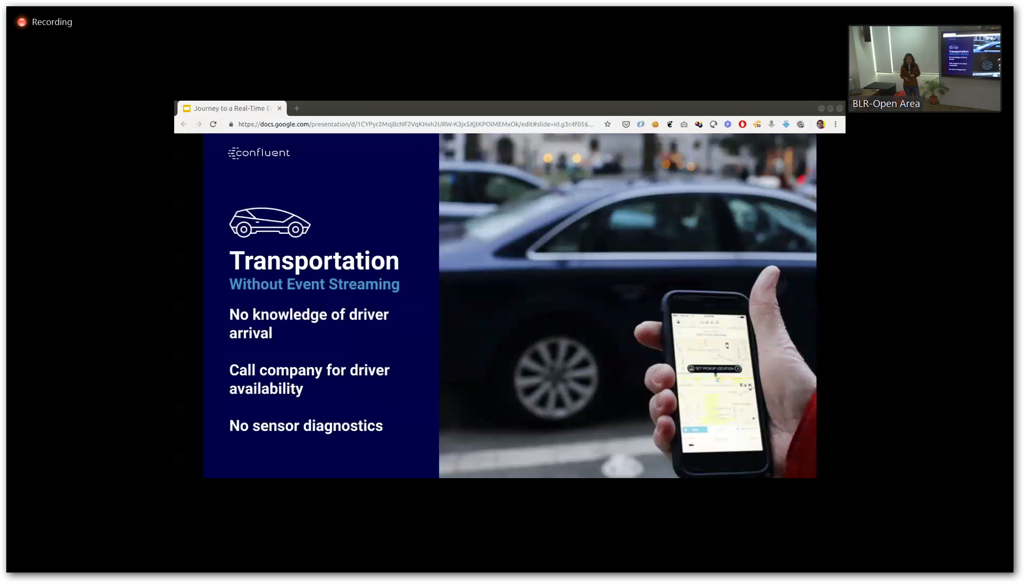

Slide 17
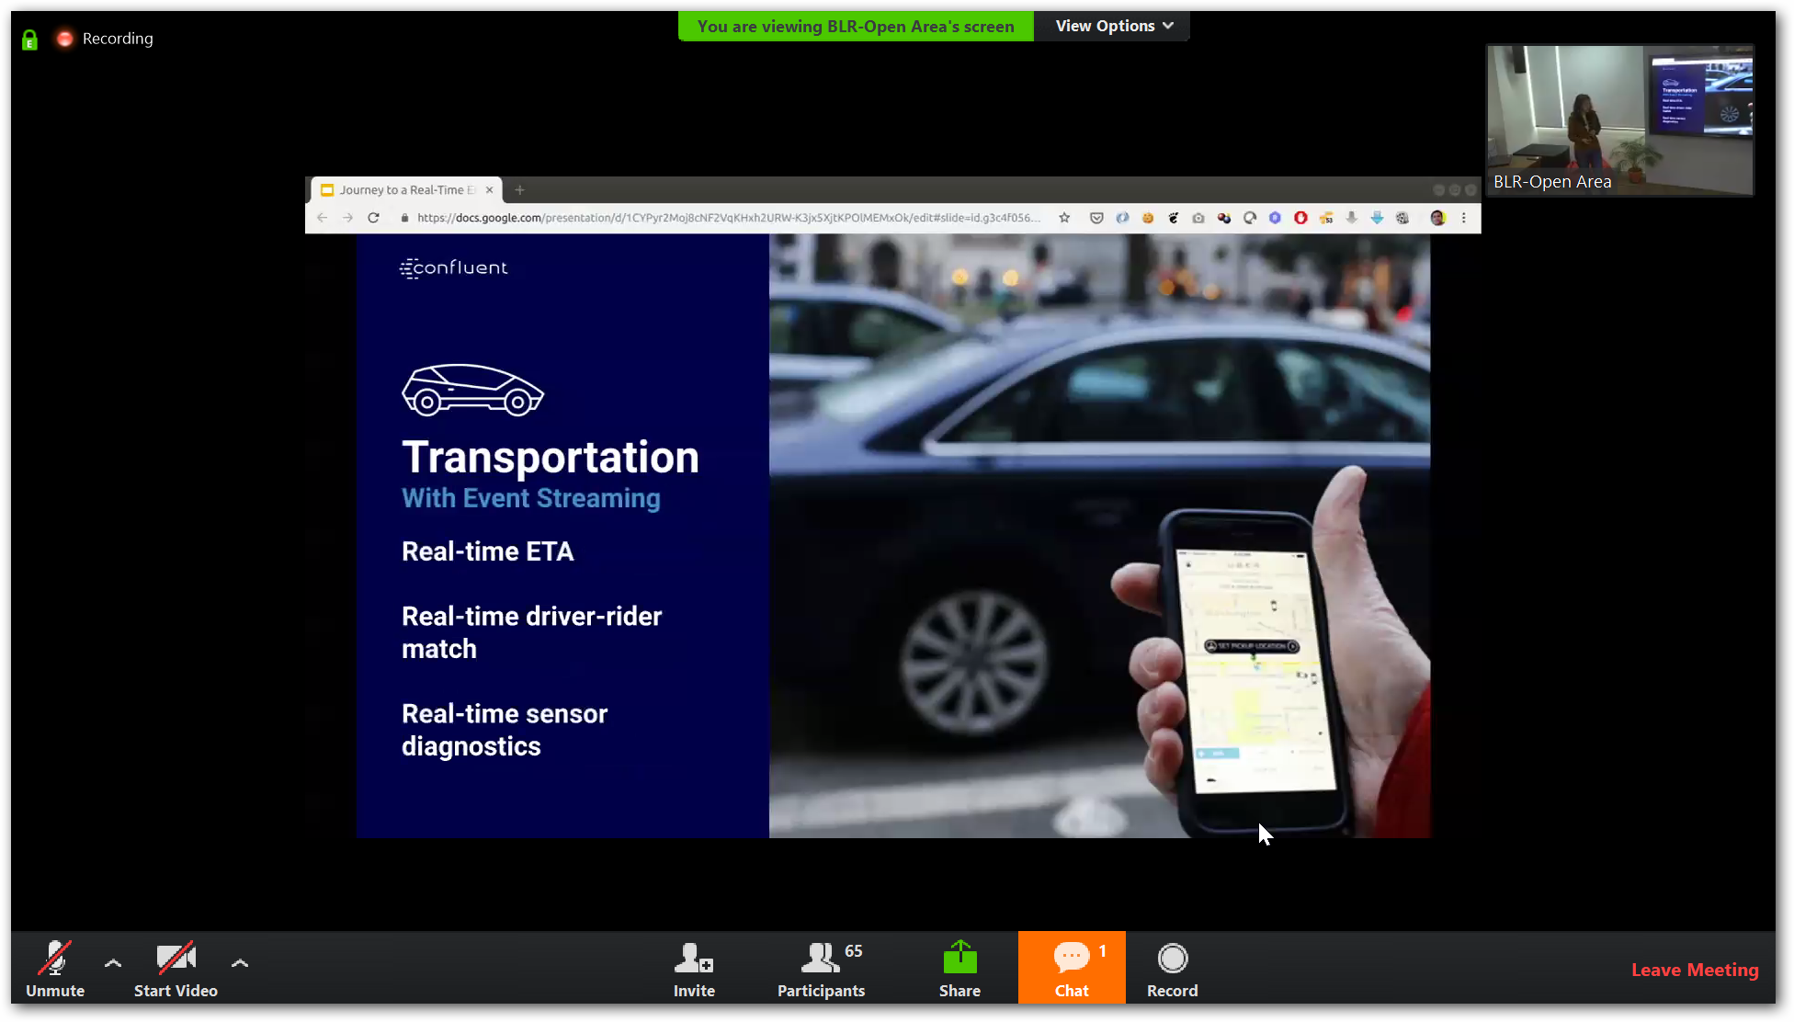

Slide 18
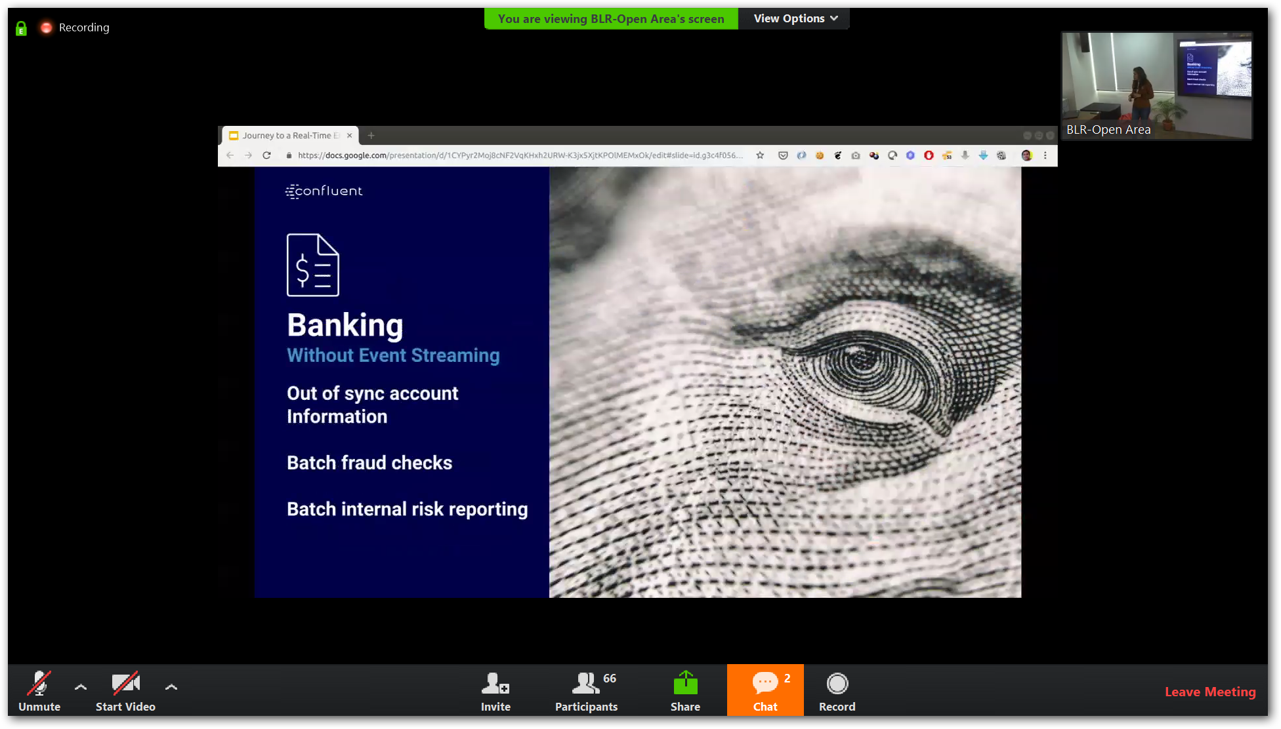

Slide 19
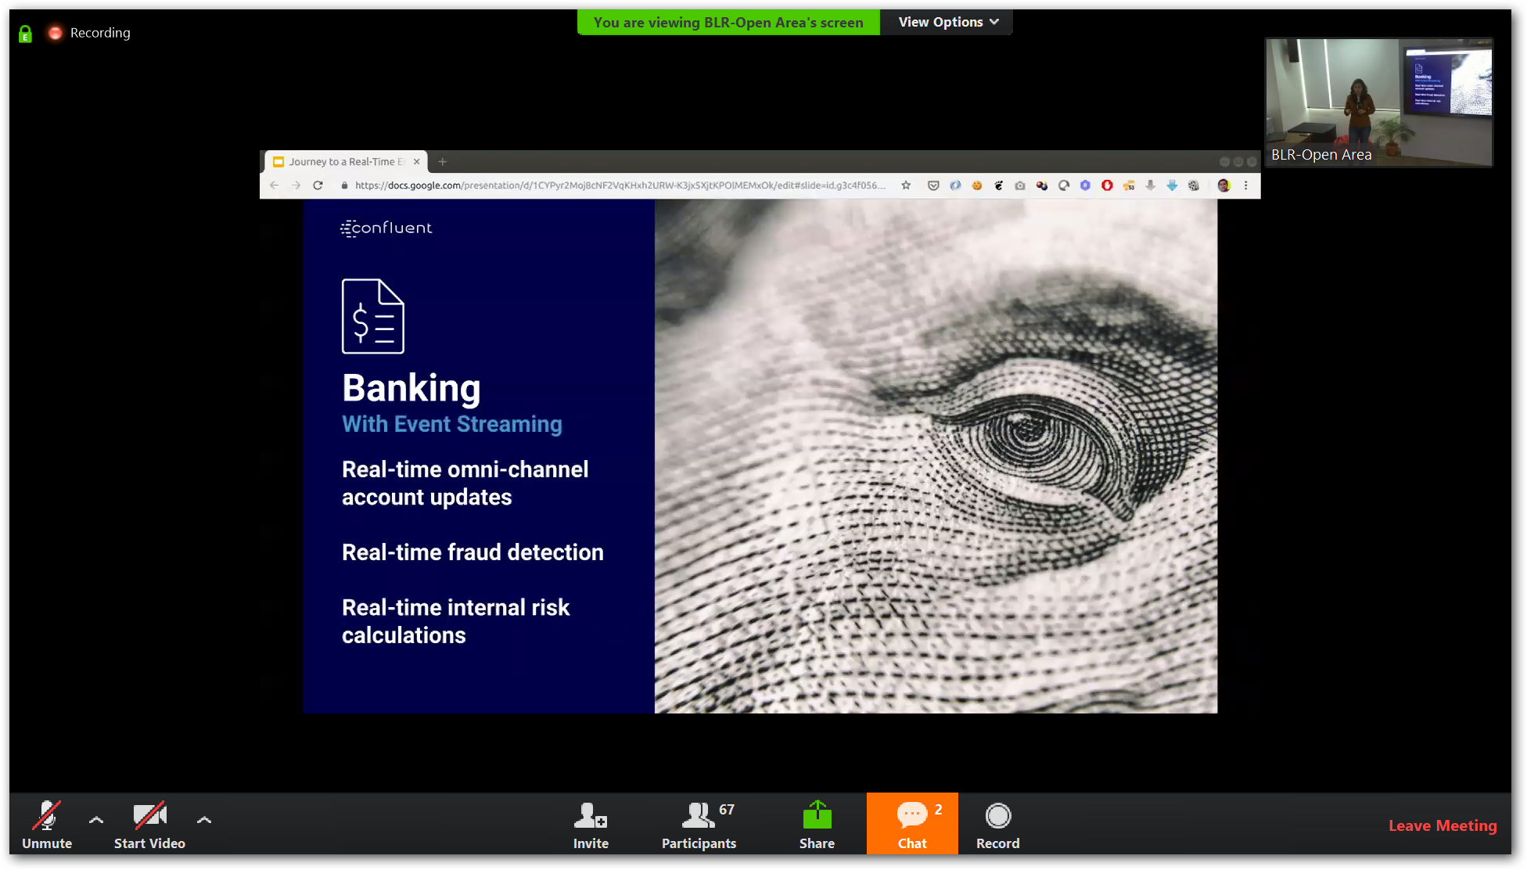

Slide 20
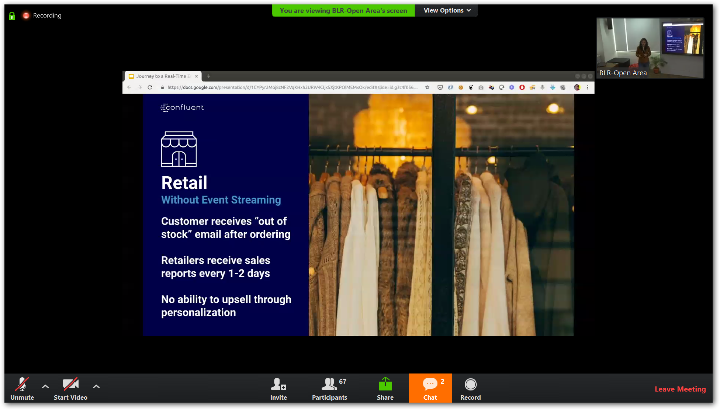

Slide 21
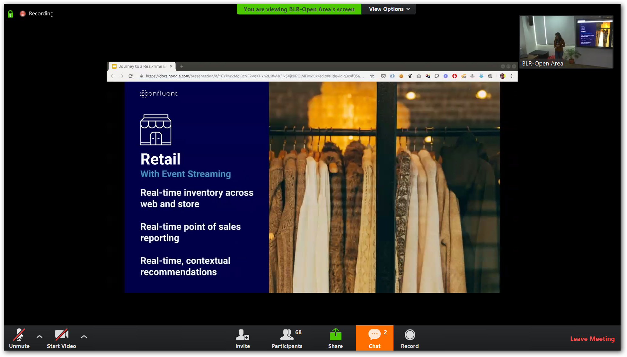

Slide 22
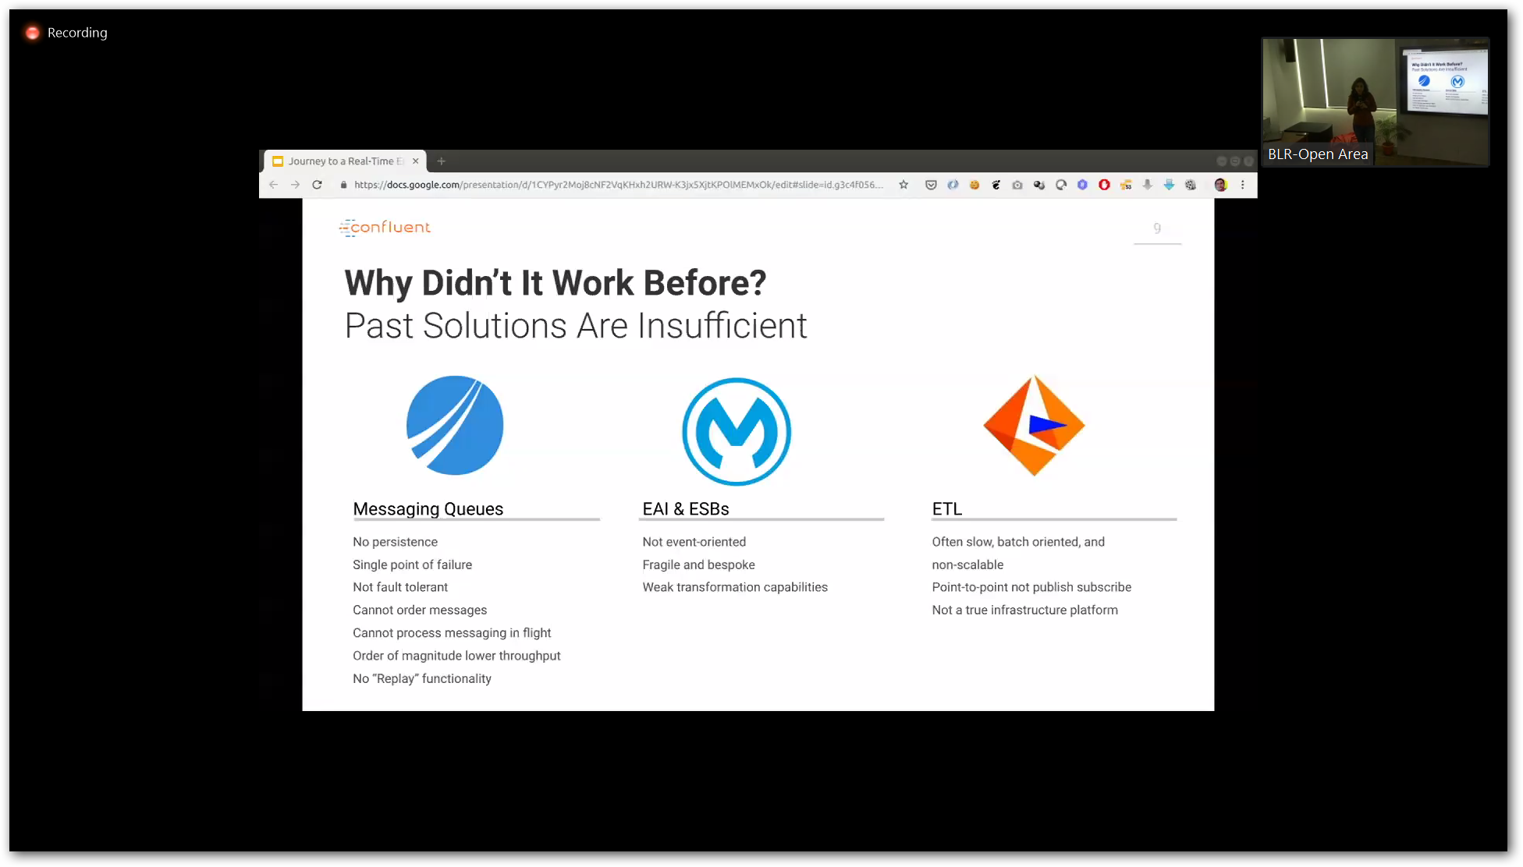

Slide 23
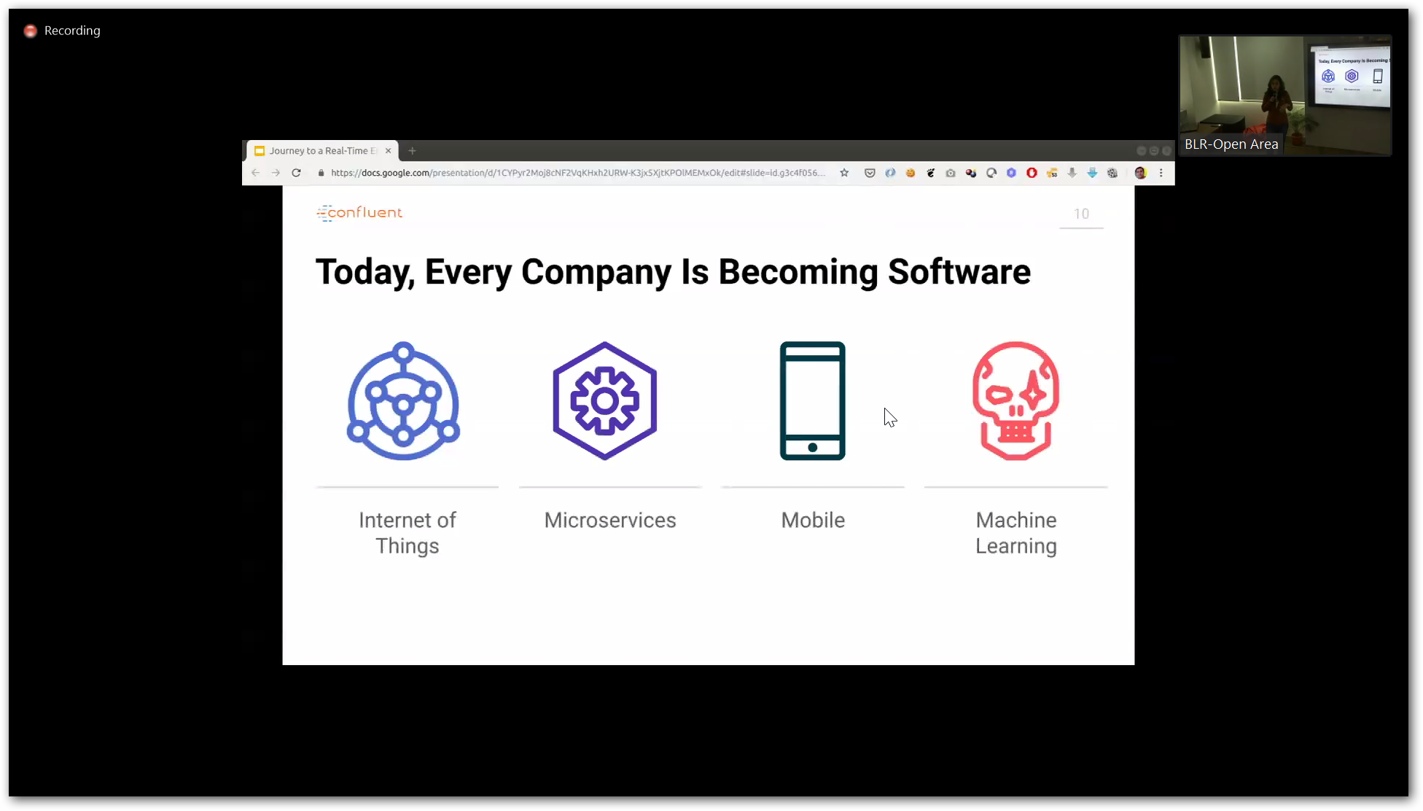

Slide 24
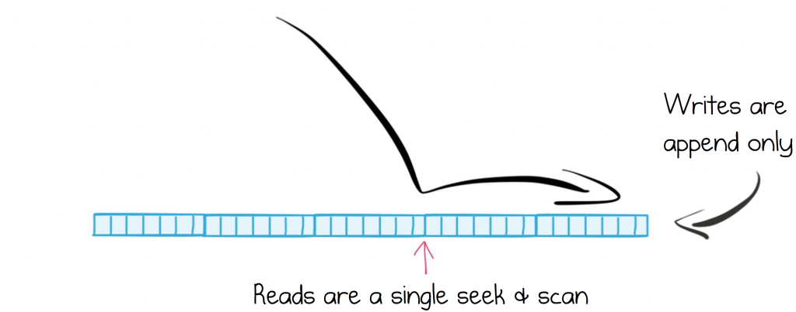
Efficient Structure for Retaining and Distributing Messages

Slide 25
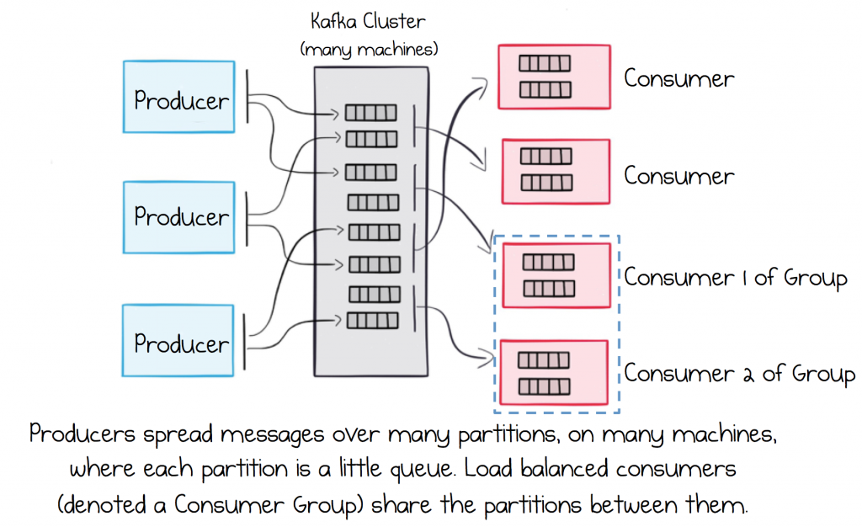
Rely on a Broker that Scales Out Linearly

Slide 26
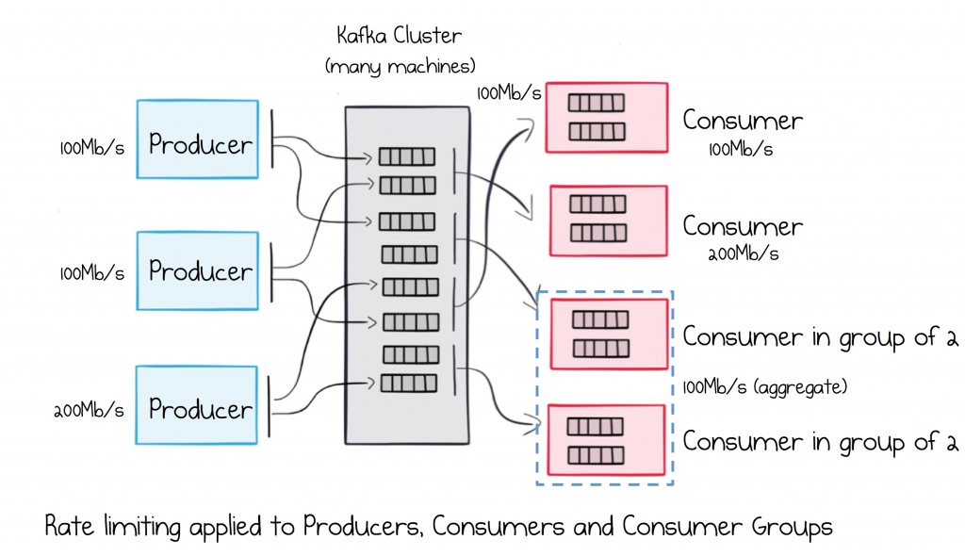
Segregate Load in Multi-Service Ecosystems

Slide 27
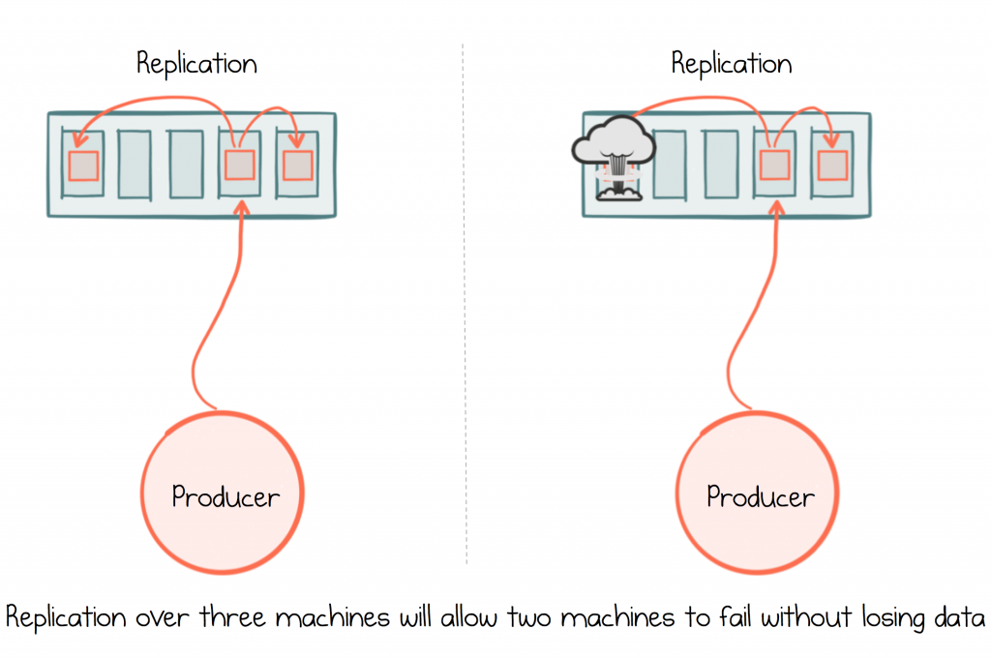
Ensure Messages are Durable

Slide 28
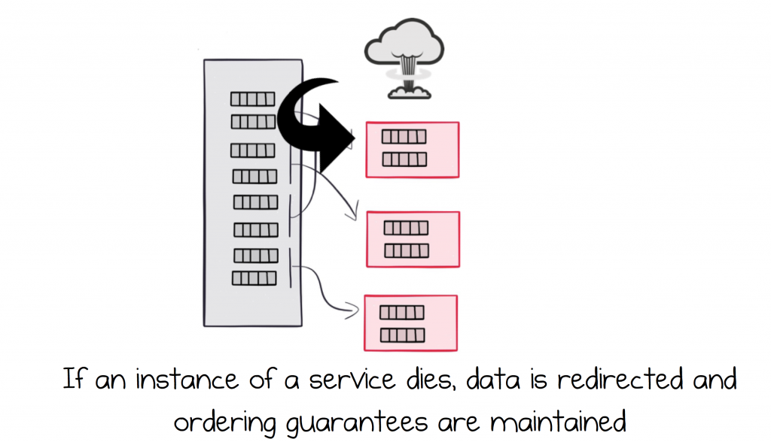
Load Balance Services and make them Highly Available

Slide 29
Bold BI dashboards
· Spark DStream Dashboard - https://webinar.boldbi.com/bi/en-us/dashboards/bf3c3851-ffff-4f13-a006-0d4c914240e3/practice/spark-streaming-azure-sql-demo
· Kafka Dashboard - https://webinar.boldbi.com/bi/en-us/dashboards/cc8257fd-f914-4f8e-ad73-2faf63f48a5d/practice/kafka%20logs%20demo

